Slide 1
Think NXT Program
SQL Server Database training – Session2
SQL Basics
2023

Slide 2
Agenda
Introduction to SQL
SQL Datatypes
SQL Commands
SQL Operators
SQL Clauses
SQL Aggregate Functions
SQL Joins
SQL SET Operators

Slide 3
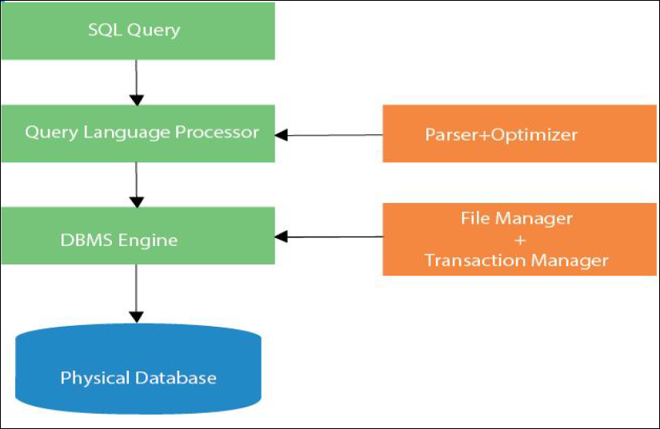
What is SQL
SQL stands for Structured Query Language. It is used for storing and managing data in Relational Database Management System (RDBMS).
It is a standard language for Relational Database System. It enables a user to create, read, update and delete relational databases and tables.
All the RDBMS like MySQL, Informix, Oracle, MS Access and SQL Server use SQL as their standard database language.
SQL allows users to query the database in several ways, using English-like statements.
What is Advantages of SQL?
High speed
No coding needed
Well defined standards
Portability
Interactive language
Multiple data view

Slide 4
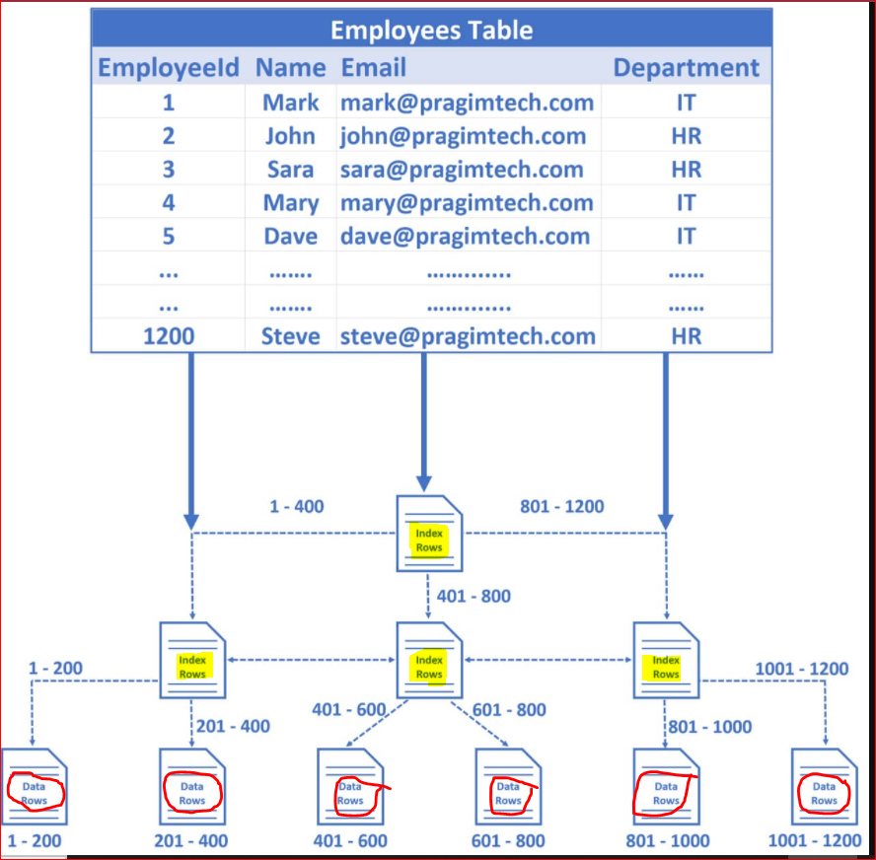
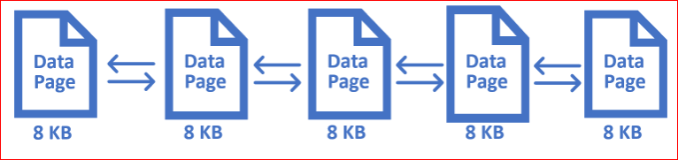
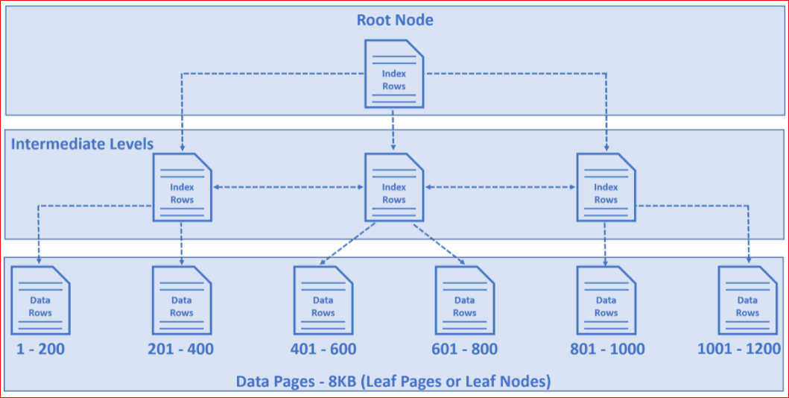
Data Stored in SQL Table

Slide 5
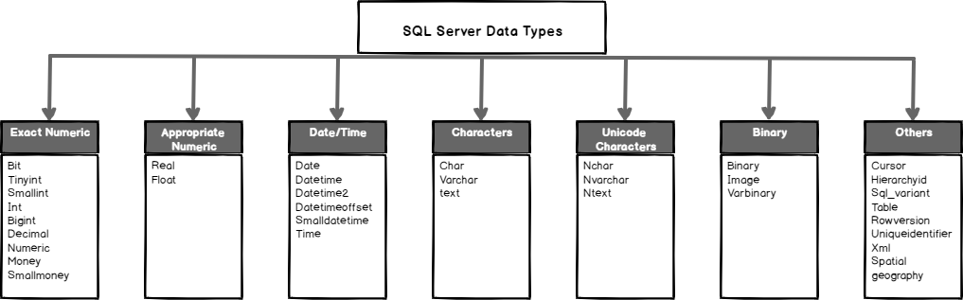
SQL Data Types
SQL Datatype is used to define the values that a column can contain.
Every column is required to have a name and data type in the database table.

Slide 6
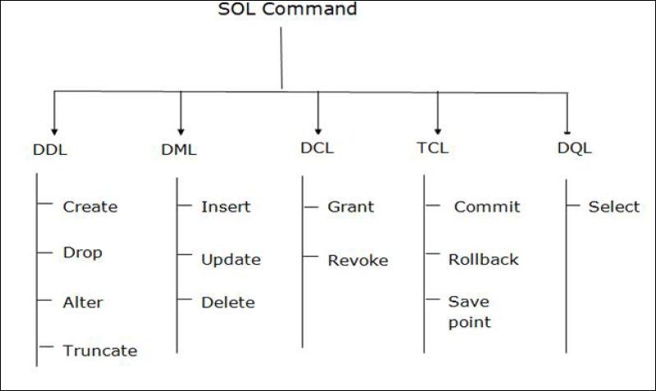
SQL Commands
SQL commands are instructions. It is used to communicate with the database. It is also used to perform specific tasks, functions, and queries of data.
• SQL can perform various tasks like create a table, add data to tables, drop the table, modify the table, set
permission for users.

Slide 7
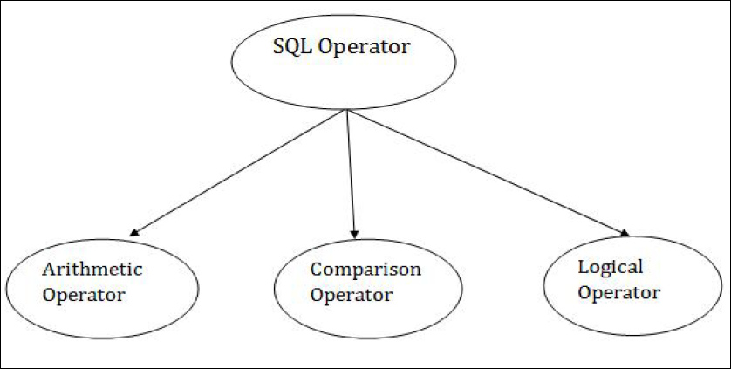
SQL Operators
Arithmetic Operators
Operator | Desc
+ | It adds the value of both operands.
- | It is used to subtract the right-hand operand from the left-hand operand.
* | It is used to multiply the value of both operands.
/ | It is used to divide the left-hand operand by the right-hand operand.
% | It is used to divide the left-hand operand by the right-hand operand and returns reminder.

Slide 8
SQL Operators
Comparison Operators
Operator | Desc
= | It checks if two operands' values are equal or not, if the values are queal then condition becomes true.
!= | It checks if two operands' values are equal or not, if values are not equal, then condition becomes true.
<> | It checks if two operands' values are equal or not, if values are not equal then condition becomes true.
> | It checks if the left operand value is greater than right operand value, if yes then condition becomes true.
< | It checks if the left operand value is less than right operand value, if yes then condition becomes true.
>= | It checks if the left operand value is greater than or equal to the right operand value, if yes then condition becomes true.
<= | It checks if the left operand value is less than or equal to the right operand value, if yes then condition becomes true.
!< | It checks if the left operand value is not less than the right operand value, if yes then condition becomes true.
!> | It checks if the left operand value is not greater than the right operand value, if yes then condition becomes true.

Slide 9
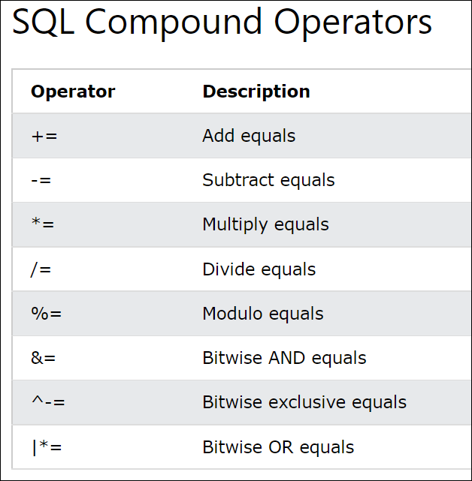
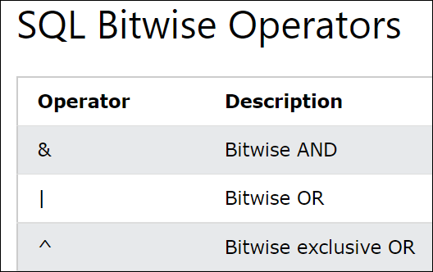
SQL Operators

Slide 10
SQL Operators
Logical Operators
Operator | Desc
All | It compares a value to all values in another value set.
AND | It allows the existence of multiple conditions in an SQL statement.
ANY | It compares the values in the list according to the condition.
Between | It is used to search for values that are within a set of values.
IN | It compares a value to that specified list value.
NOT | It reverses the meaning of any logical operator.
OR | It combines multiple conditions in SQL statements.
EXIST | It is used to search for the presence of a row in a specified table.
LIKE | It compares a value to similar values using wildcard operator.

Slide 11
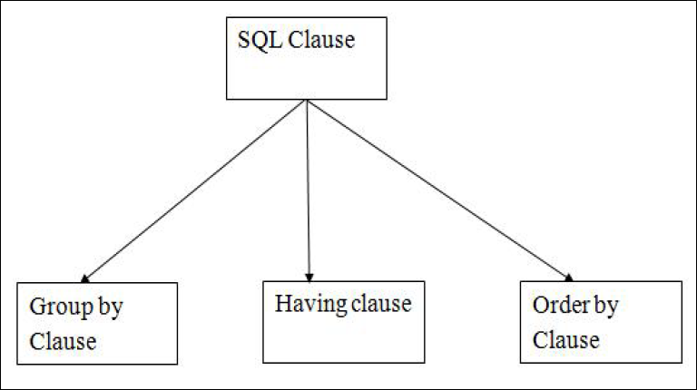
SQL Clauses
GROUP BY statement is used to arrange identical data into groups.
GROUP BY statement is used with the SQL SELECT statement.
GROUP BY statement follows the WHERE clause in a SELECT statement and precedes the ORDER BY clause.
GROUP BY statement is used with aggregation function.
HAVING clause is used to specify a search condition for a
Group or an aggregate.
Having is used in a GROUP BY clause. If you are not using GROUP BY clause then you can use HAVING function like a WHERE clause
ORDER BY clause sorts the result-set in ascending or descending order.
It sorts the records in ascending order by default. DESC keyword is used to sort the records in descending order.

Slide 12
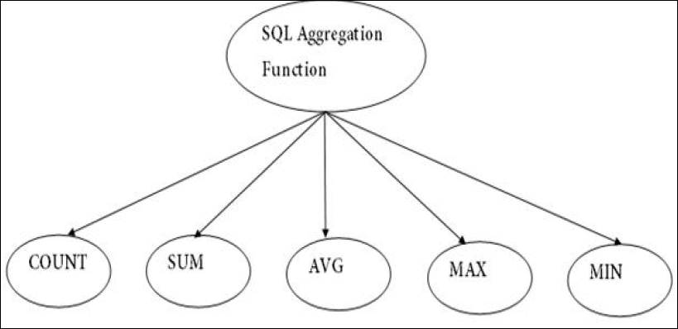
SQL Aggregate Functions
COUNT function is used to Count the number of rows in a database table. It can work on both numeric and non-numeric data types.
COUNT function uses the COUNT(*) that returns the count of all the rows in a specified table. COUNT(*) considers duplicate and Null.
SUM function is used to calculate the sum of all selected columns. It works on numeric fields only.
AVG function is used to calculate the average value of the
numeric type. AVG function returns the average of all non-Null values.
MAX function is used to find the maximum value of a certain column. This function determines the largest value of all selected values of a column.
MIN function is used to find the minimum value of a certain Column. This function determines the smallest value of all selected values of a column

Slide 13
SQL Joins
INNER JOIN selects records that have matching values in both tables as
long as the condition is satisfied. It returns the combination of all rows from both the tables where the condition satisfies.
SQL Join
LEFT JOIN returns all the values from left table and the matching values from the right table. If there is no matching join value, it will return NULL.
RIGHT JOIN returns all the values from the values from the rows of right table and the matched values from the left table. If there is no matching in both tables, it will return NULL.
INNER
LEFT
RIGHT
FULL
FULL JOIN is the result of a combination of both left and right outer join.
Join tables have all the records from both tables. It puts NULL on the place
of matches not found.

Slide 14
SQL SET Operators
SET Operators
UNION operation is used to combine the result of two or more SQL
SELECT queries.
• In the UNION operation, all the number of datatype and columns must be same in both the tables on which UNION operation is being applied.
• The UNION operation eliminates the duplicate rows from its result set.
UNION
UNION ALL
INTERSECT
MINUS
INTERSECT is used to combine two SELECT statements. The Intersect operation returns the common rows from the SELECT statements.
• In the Intersect operation, the number of datatype and columns must be the same.
• It has no duplicates, and it arranges the data in ascending order by default.
MINUS combines the result of two SELECT statements. Minus operator is used to
display the rows which are present in the first query but absent in the second query.
• It has no duplicates and data arranged in ascending order by default.

